Slide 1
Colorimetry and its application in image denoising
From Newton to Riemann’s Geometric modeling

Slide 2
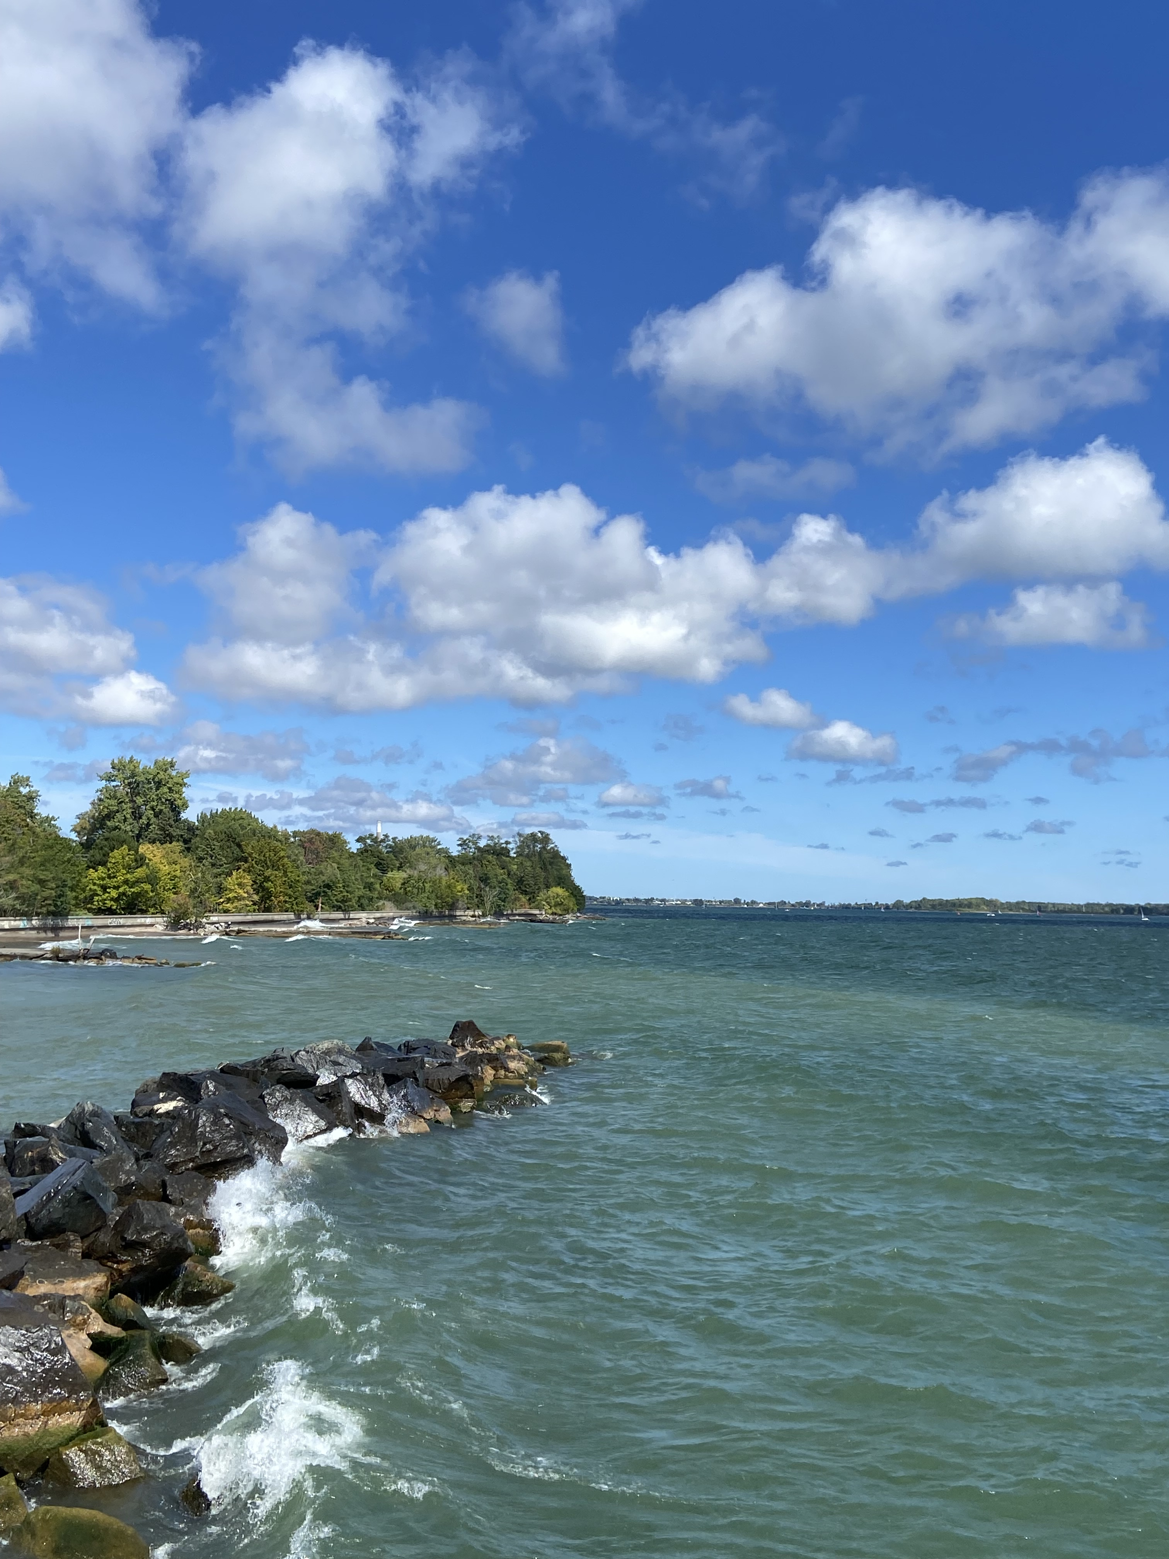
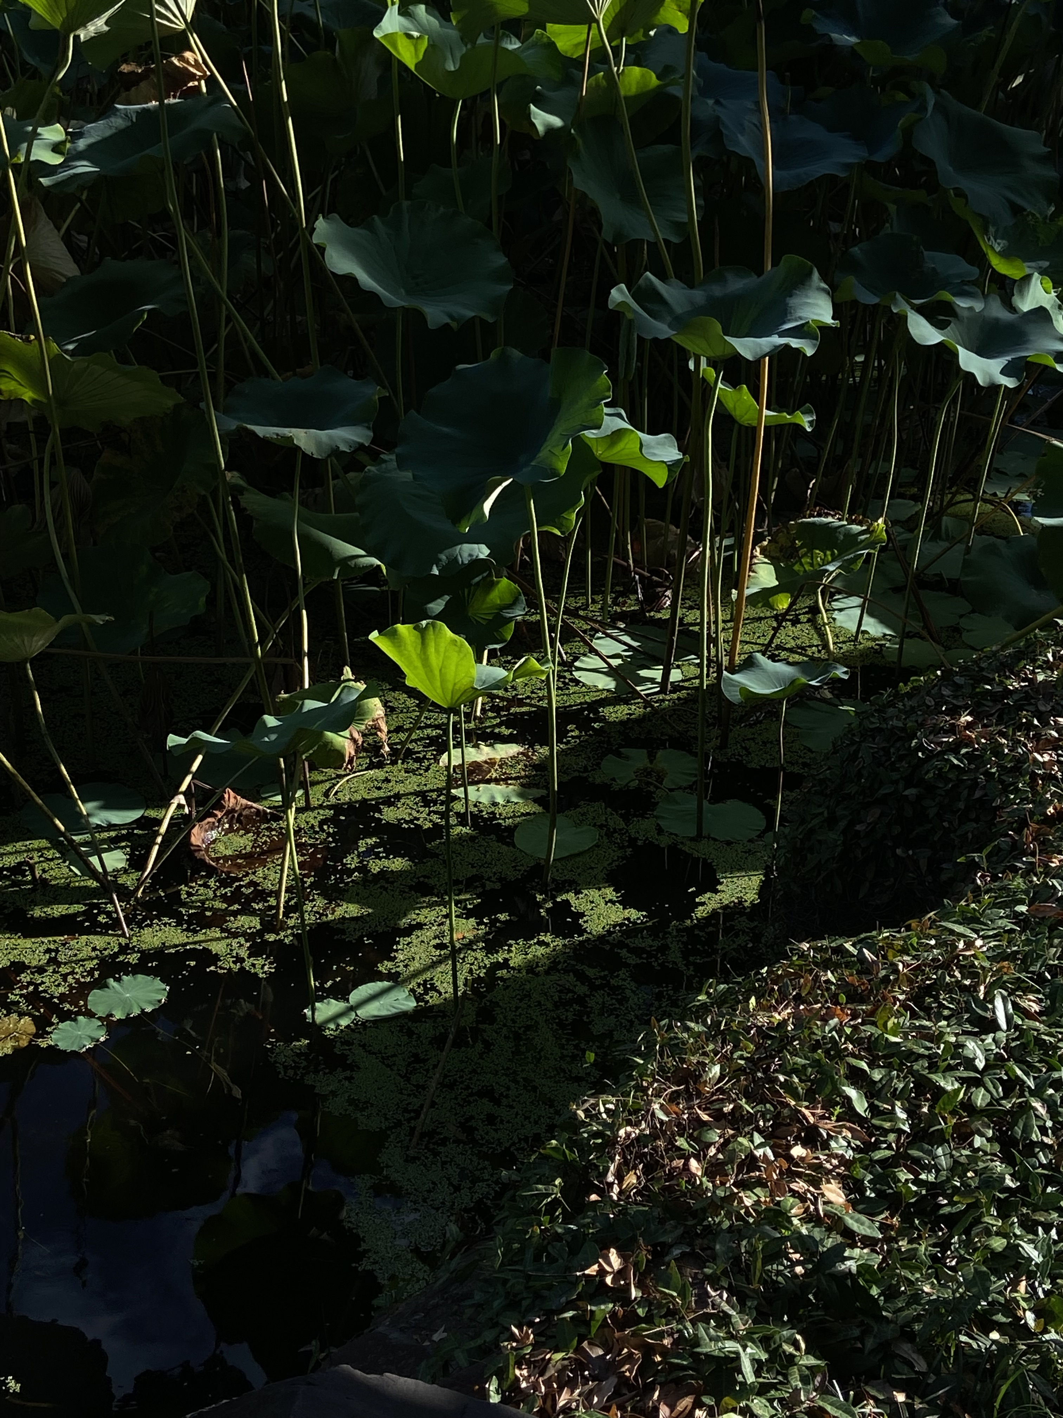
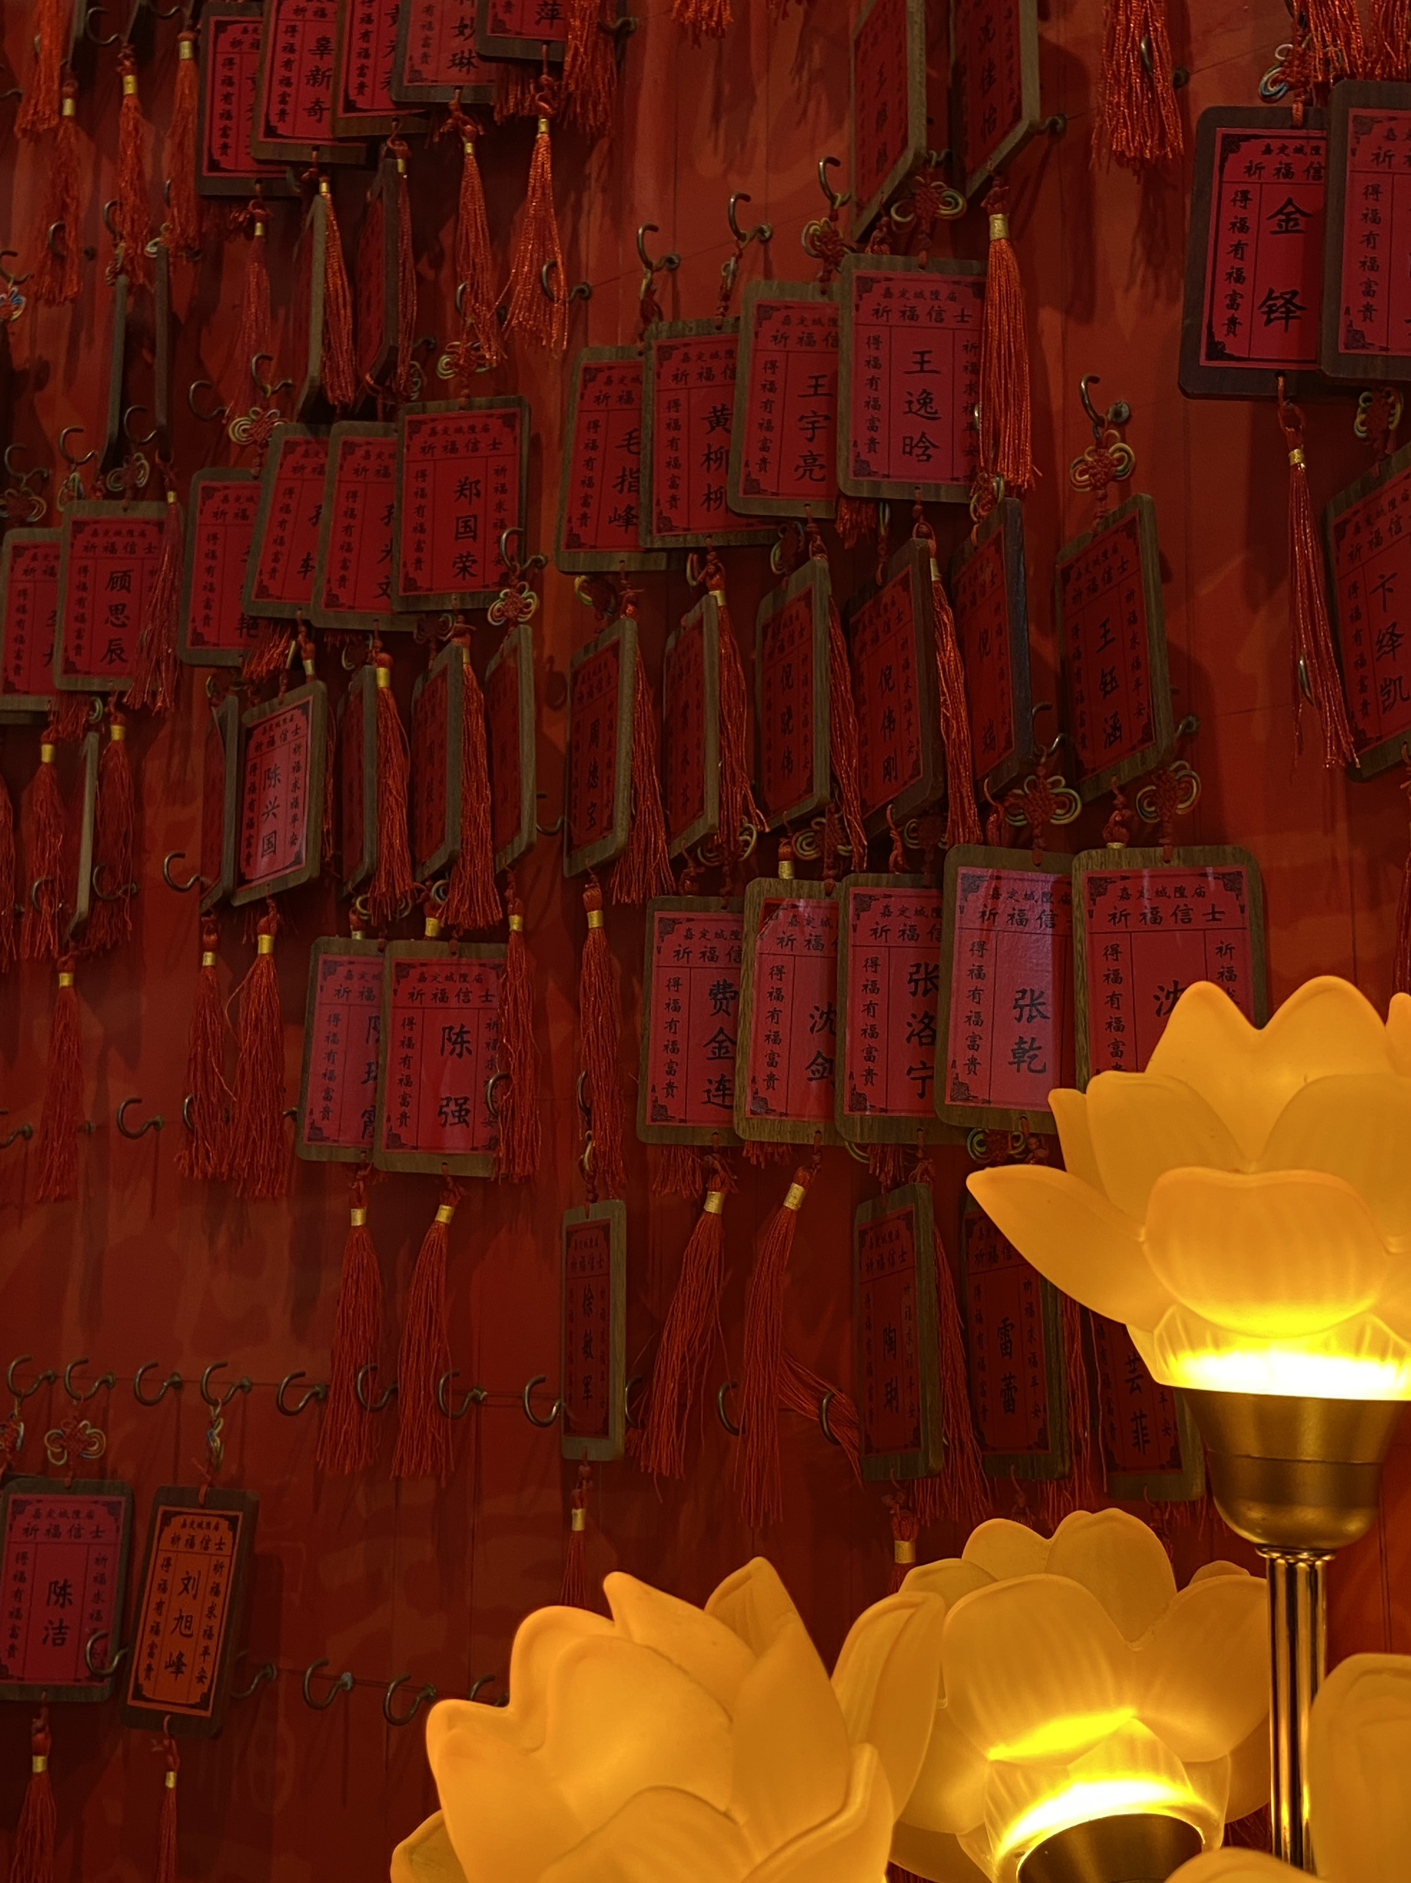

Slide 4
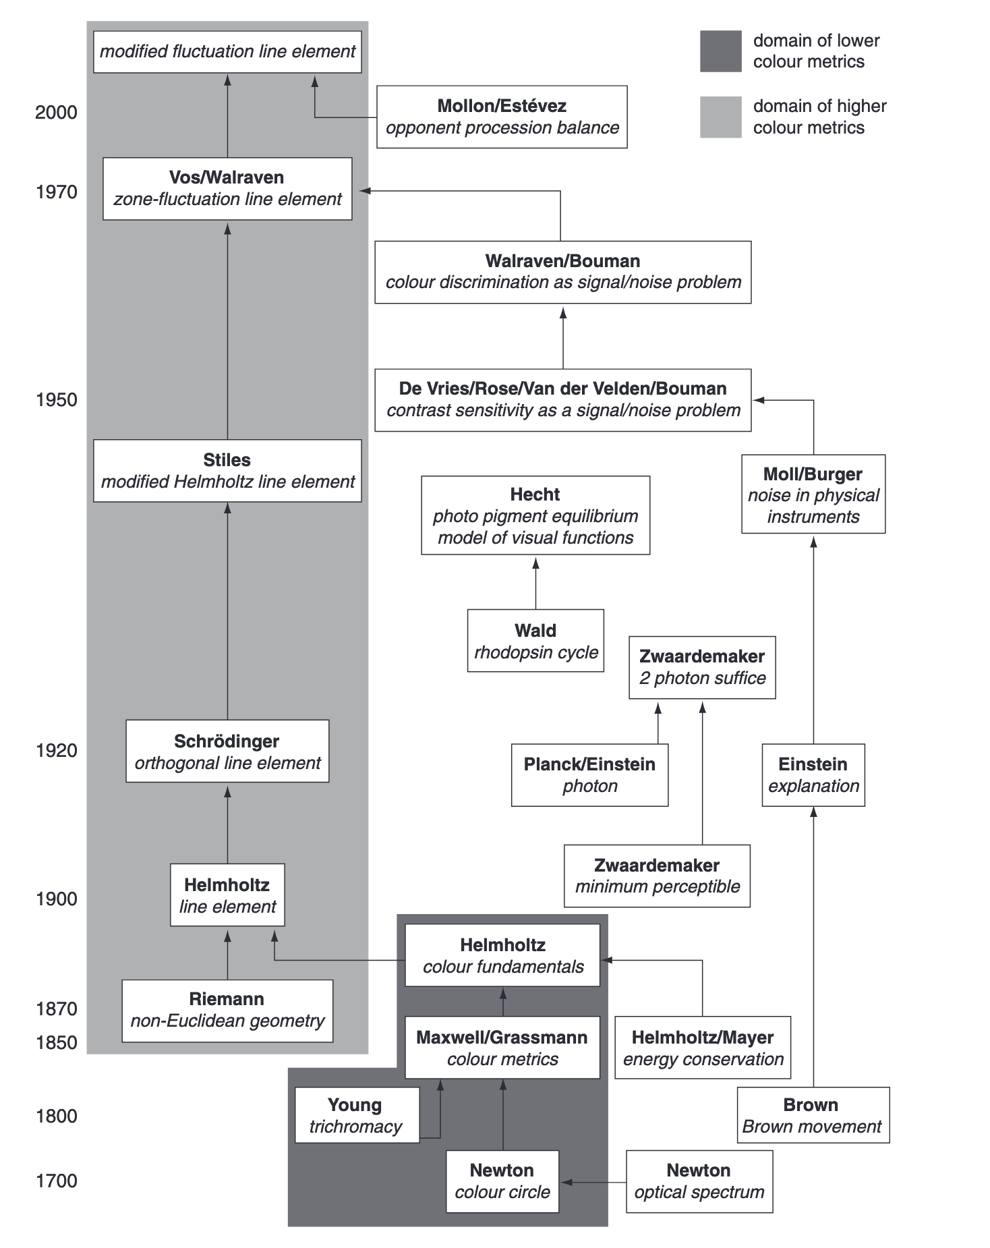

Slide 5
Early Color model: Newton’s Idea

Slide 6
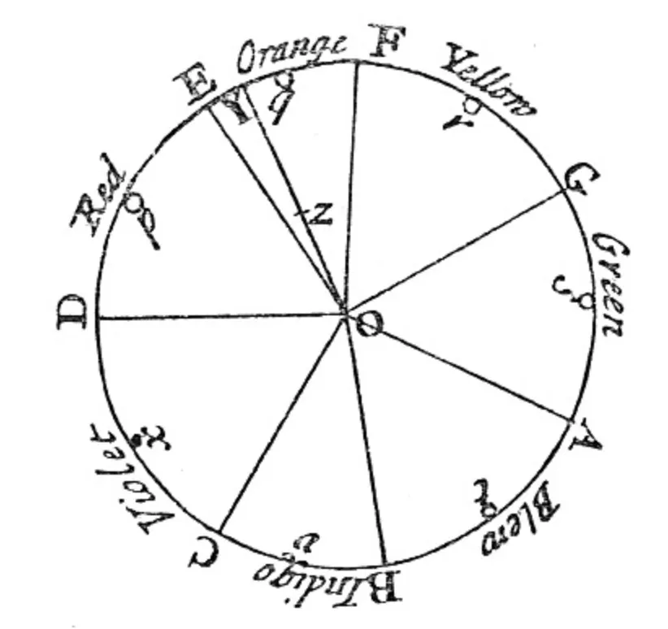
Source: [2]

Slide 7
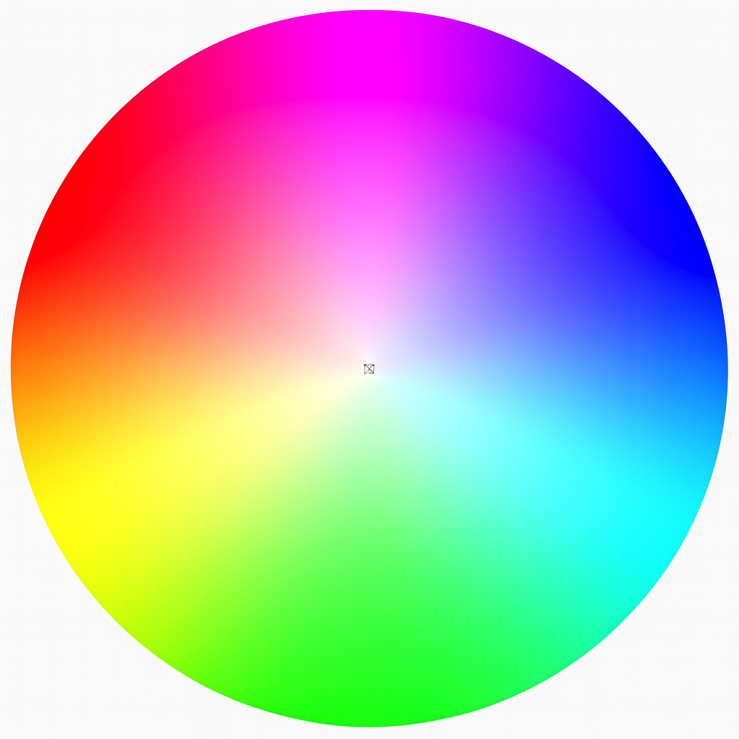
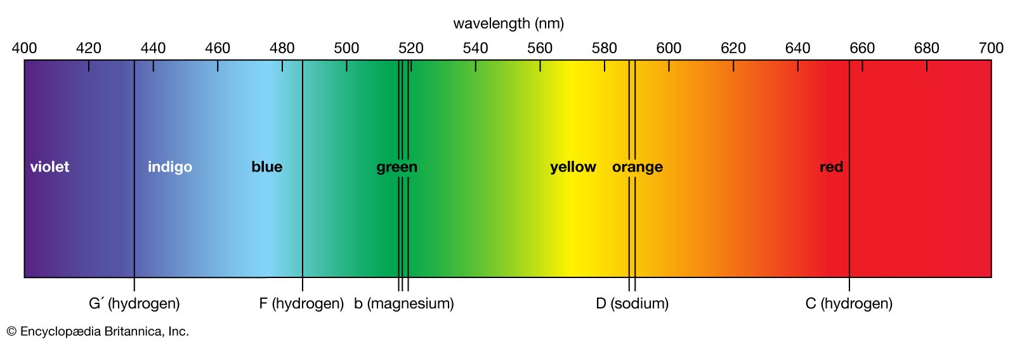
Idea
Principle colors = seven-note muical scale
Color mixing = finding barycenter of “color circles”
Source: [3]

Slide 8
Problem:
Lack of solid physics & biological support
Purple (violet) does not exist in the spectrum
Missing coordinate systems

Slide 9
Slightly Advance: Helmholtz’s Model

Slide 10
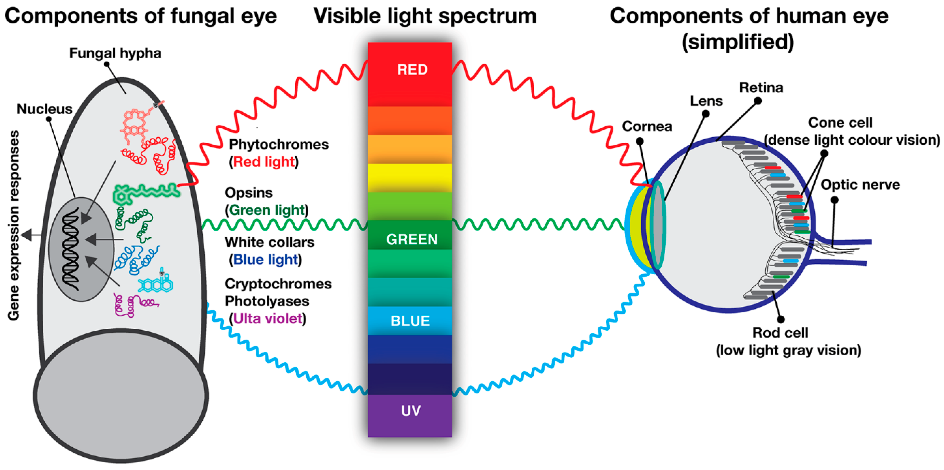
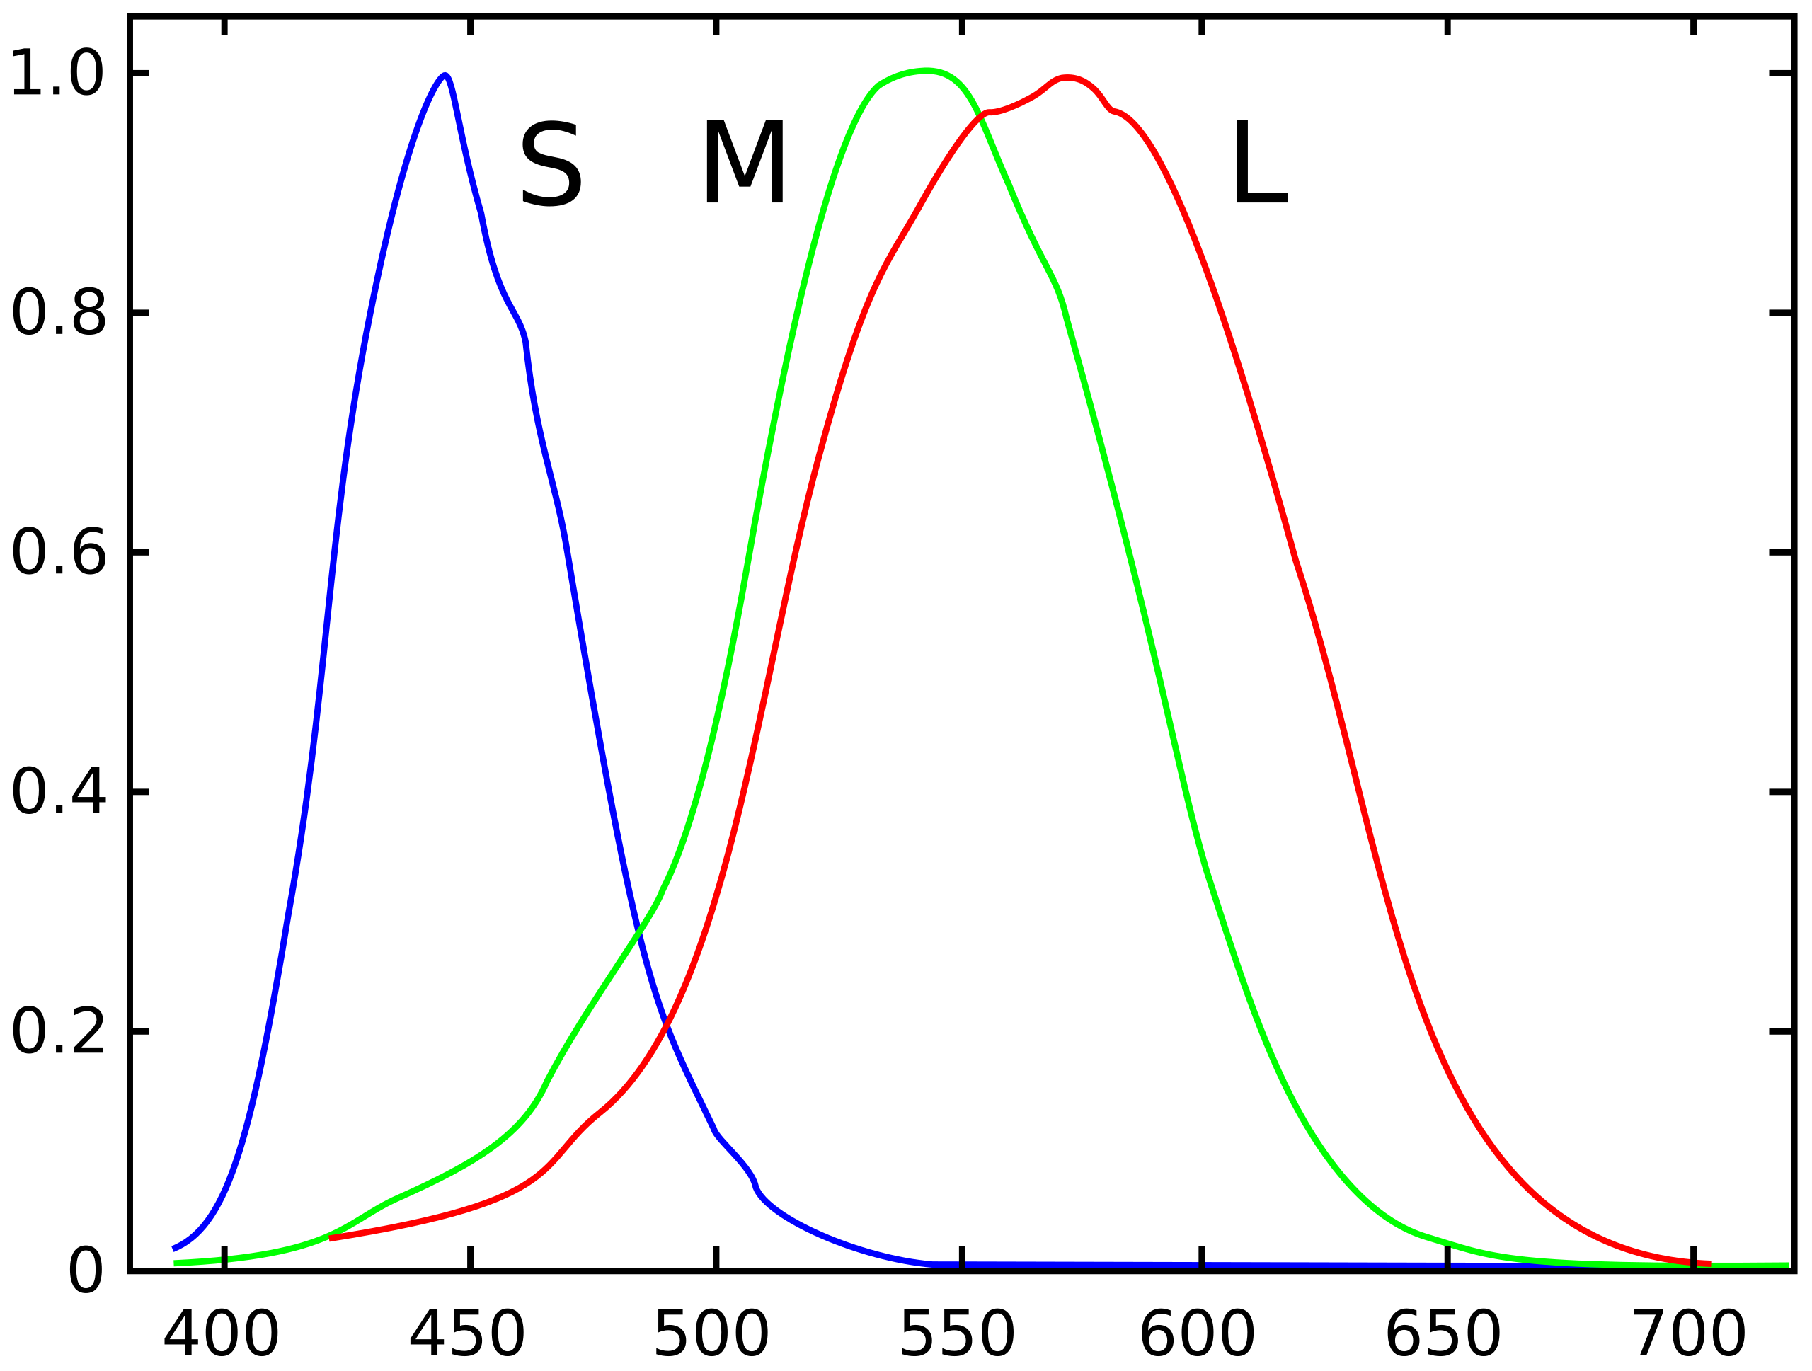
Cone Cells
Source: [4]
Source
Source: [5]

Slide 11
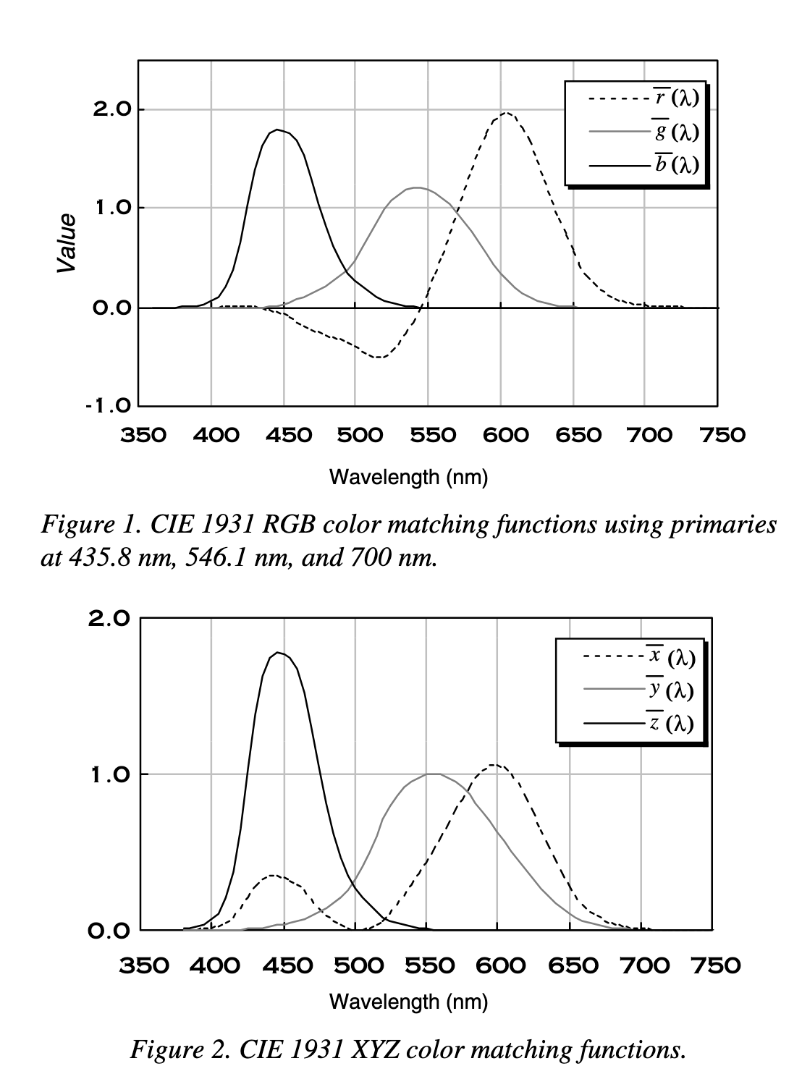
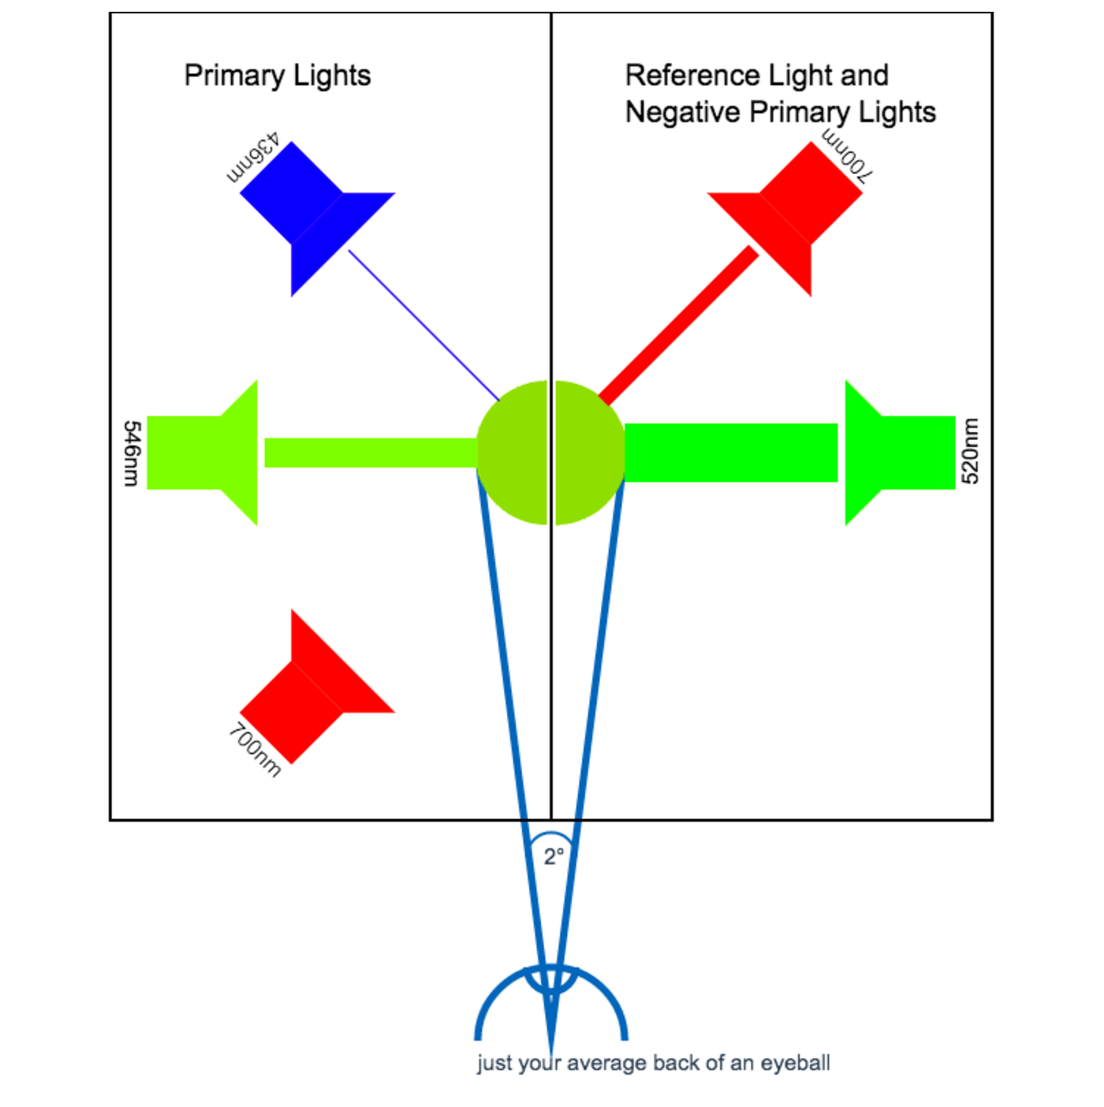
Source: [6]
Source: [7]

Slide 12
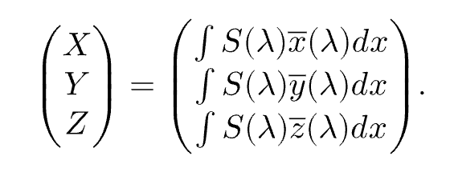

Slide 13
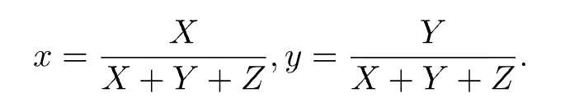
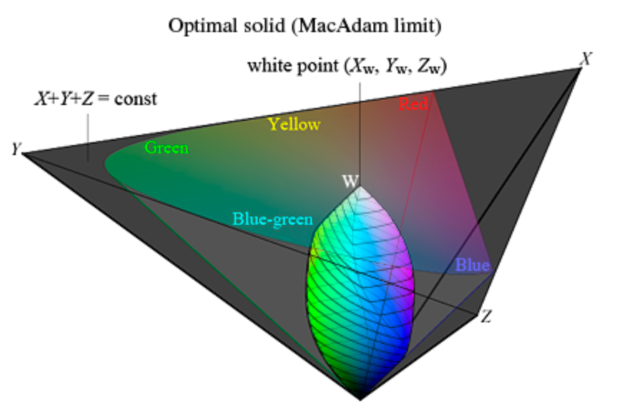
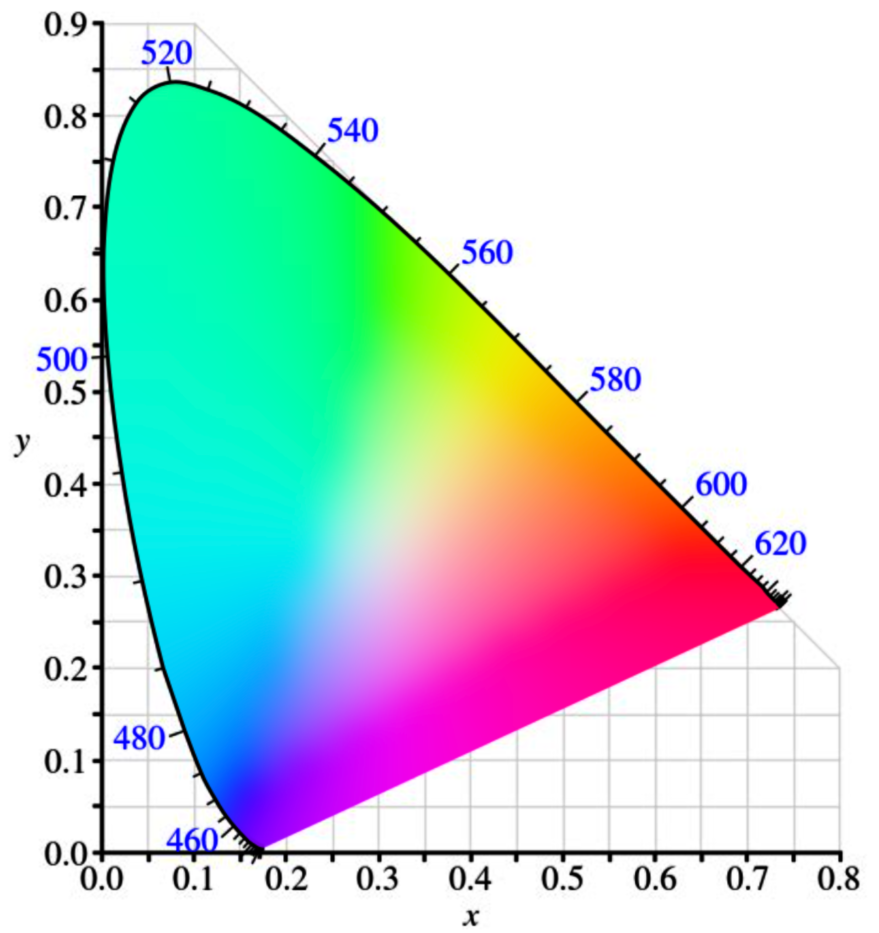
Source: [8]

Slide 14
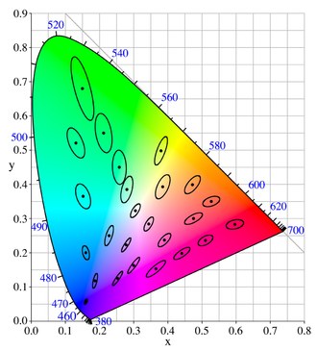
Source: [9]

Slide 15
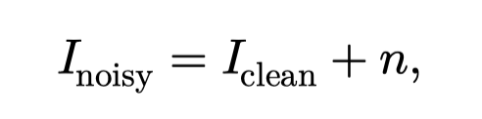
Image denoise
Recover a clean image form the noisy observation, with reasonable assumption on the noise

Slide 16
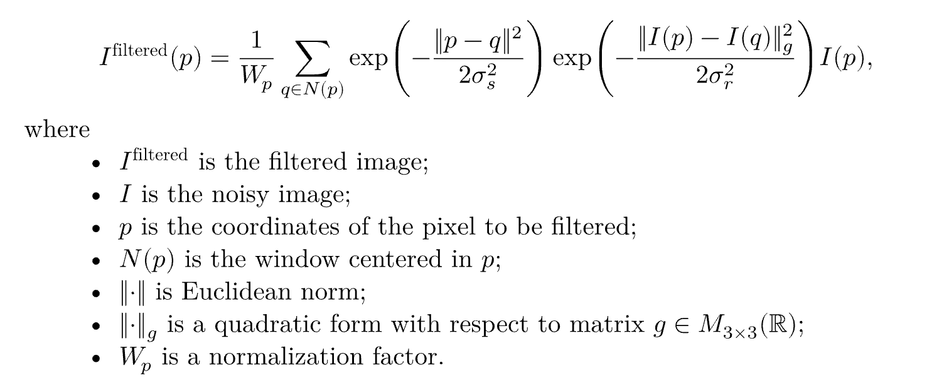
Bilateral filter

Slide 17
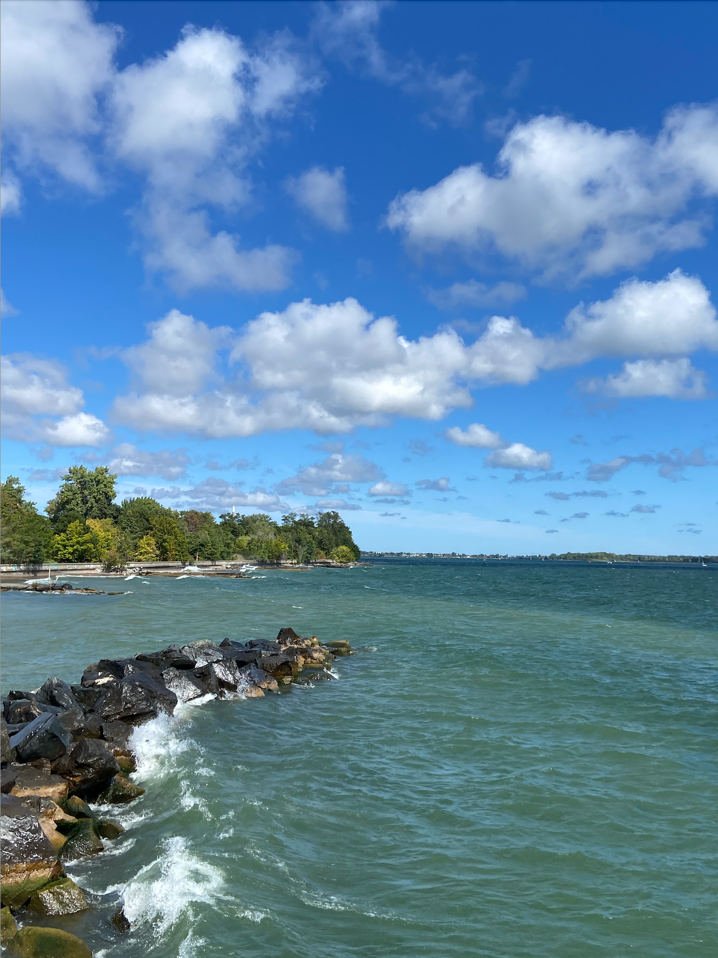
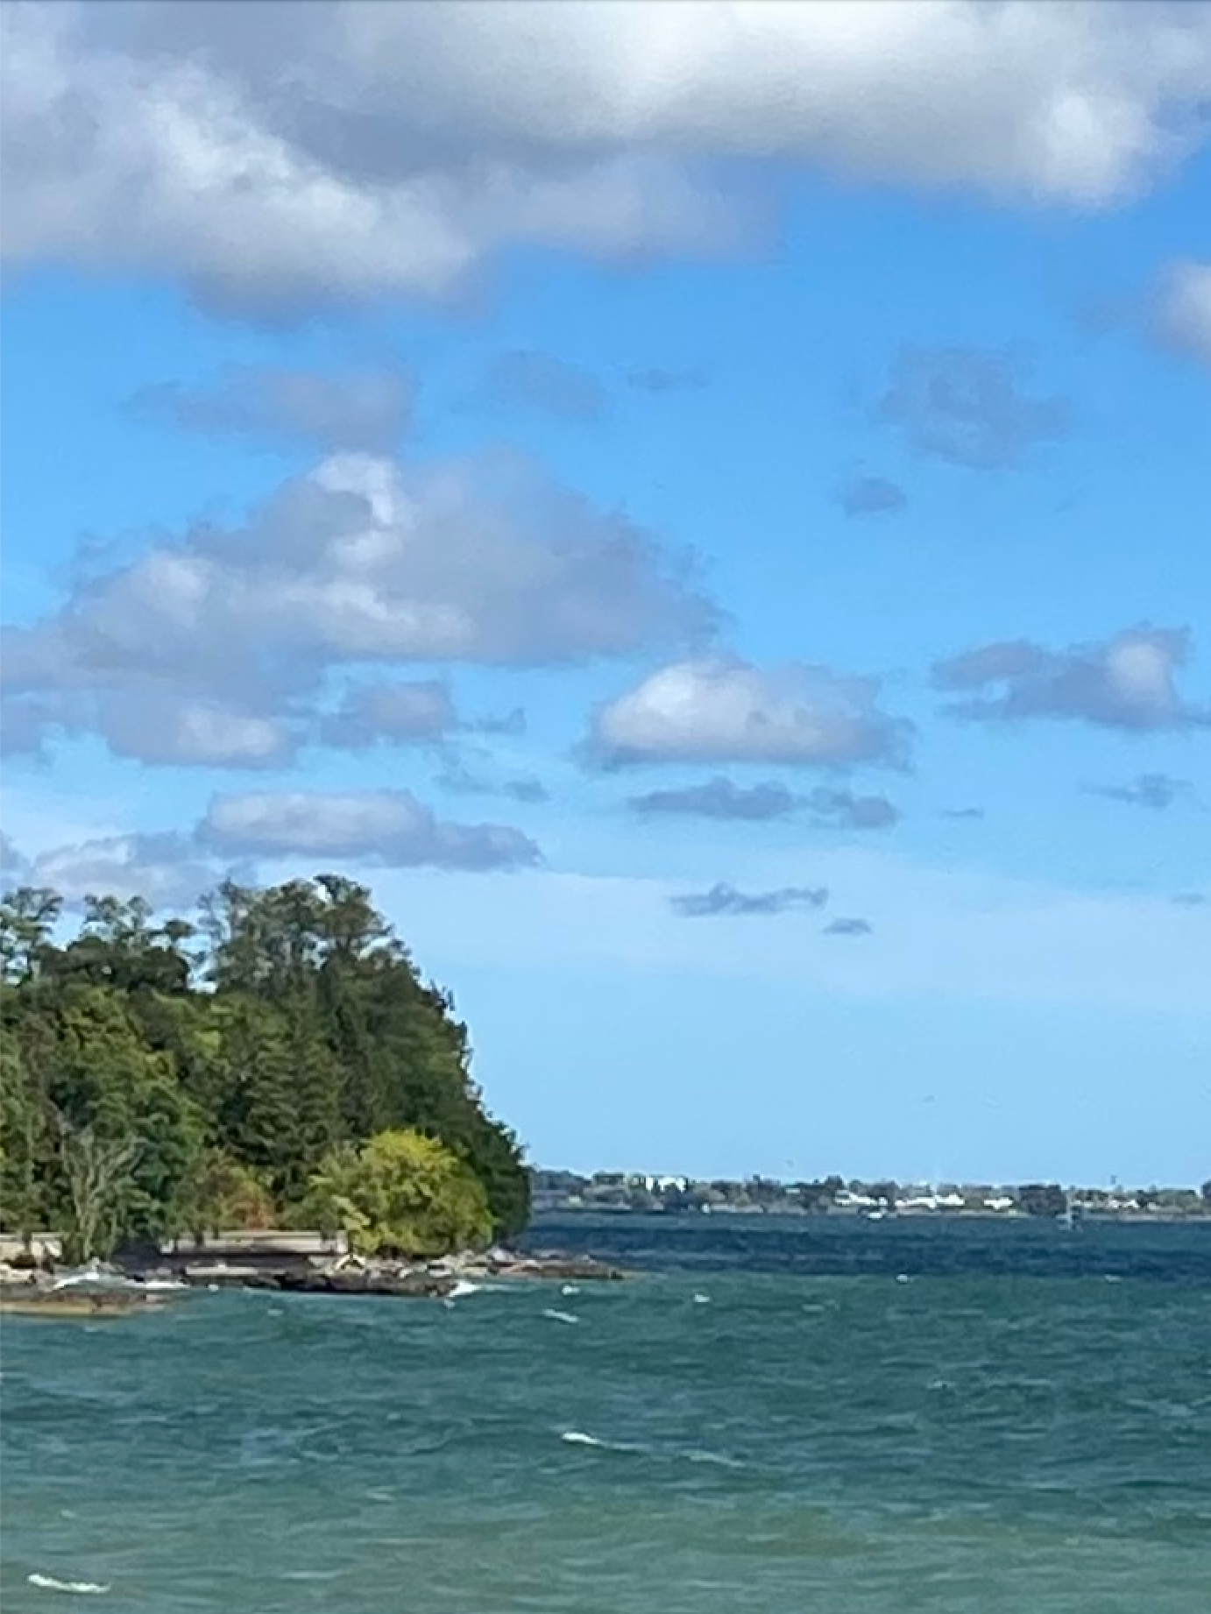
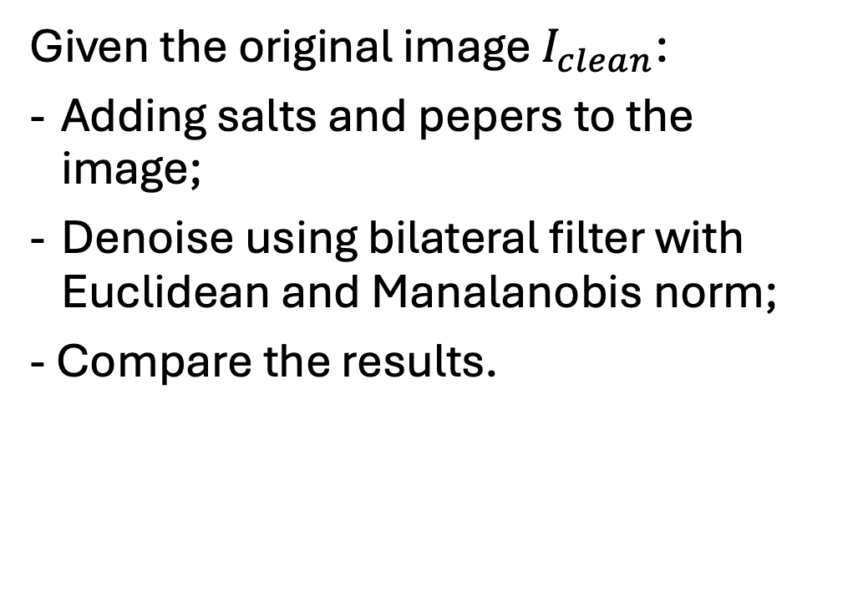
Experiement No.1
Given the original image $I_{clean}$:
Adding salts and pepers to the image;
Denoise using bilateral filter with Euclidean and Manalanobis norm;
- Compare the results.

Slide 18

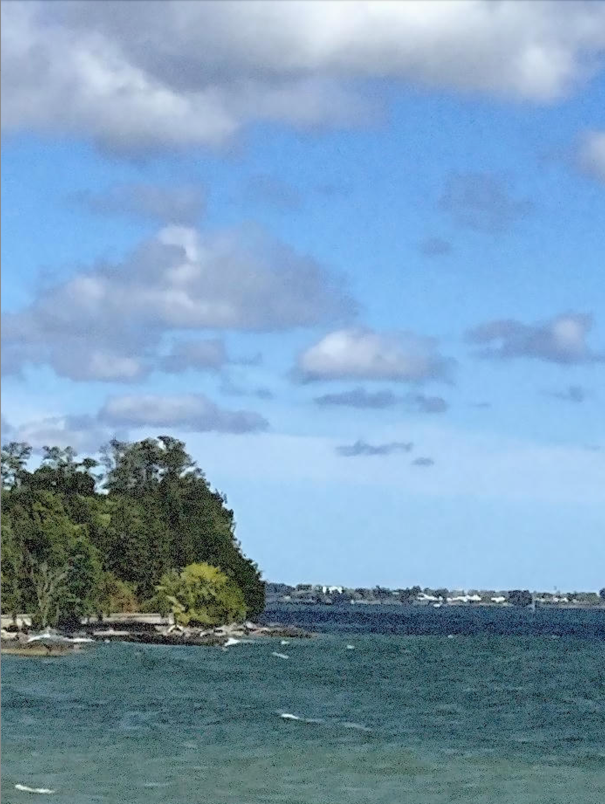
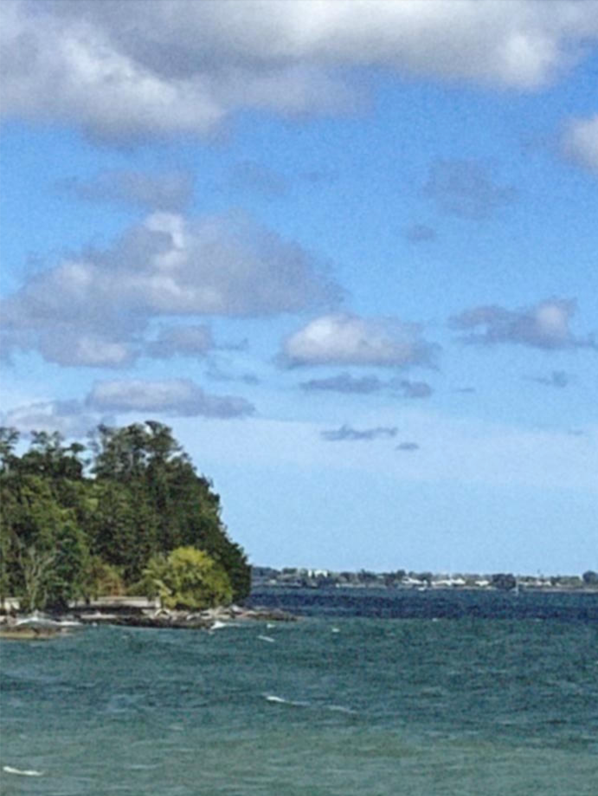
Experiment Result
Noisy Observation
Denoise with Manalanobis Norm
Denoise with L2 Norm

Slide 19

Experiement No.1
Introduce salts and pepers to the image

Slide 20
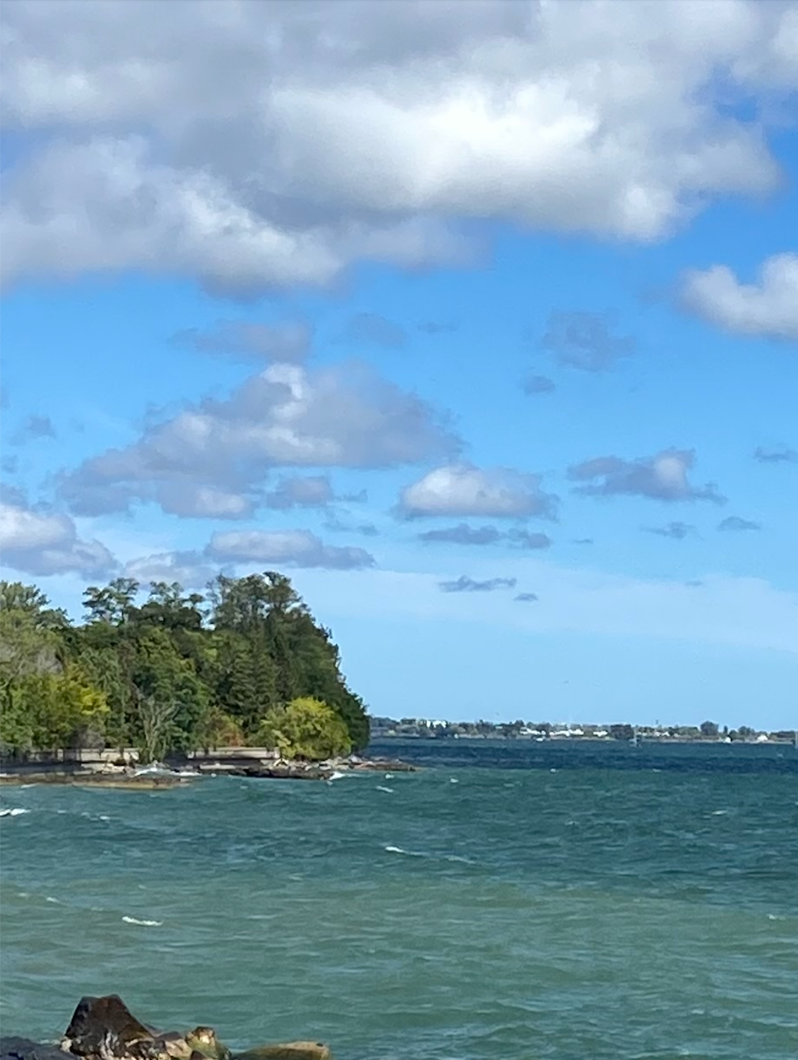
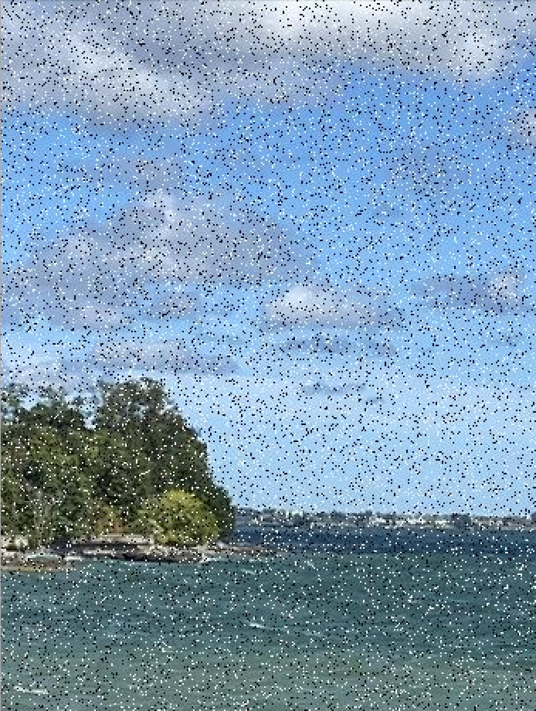
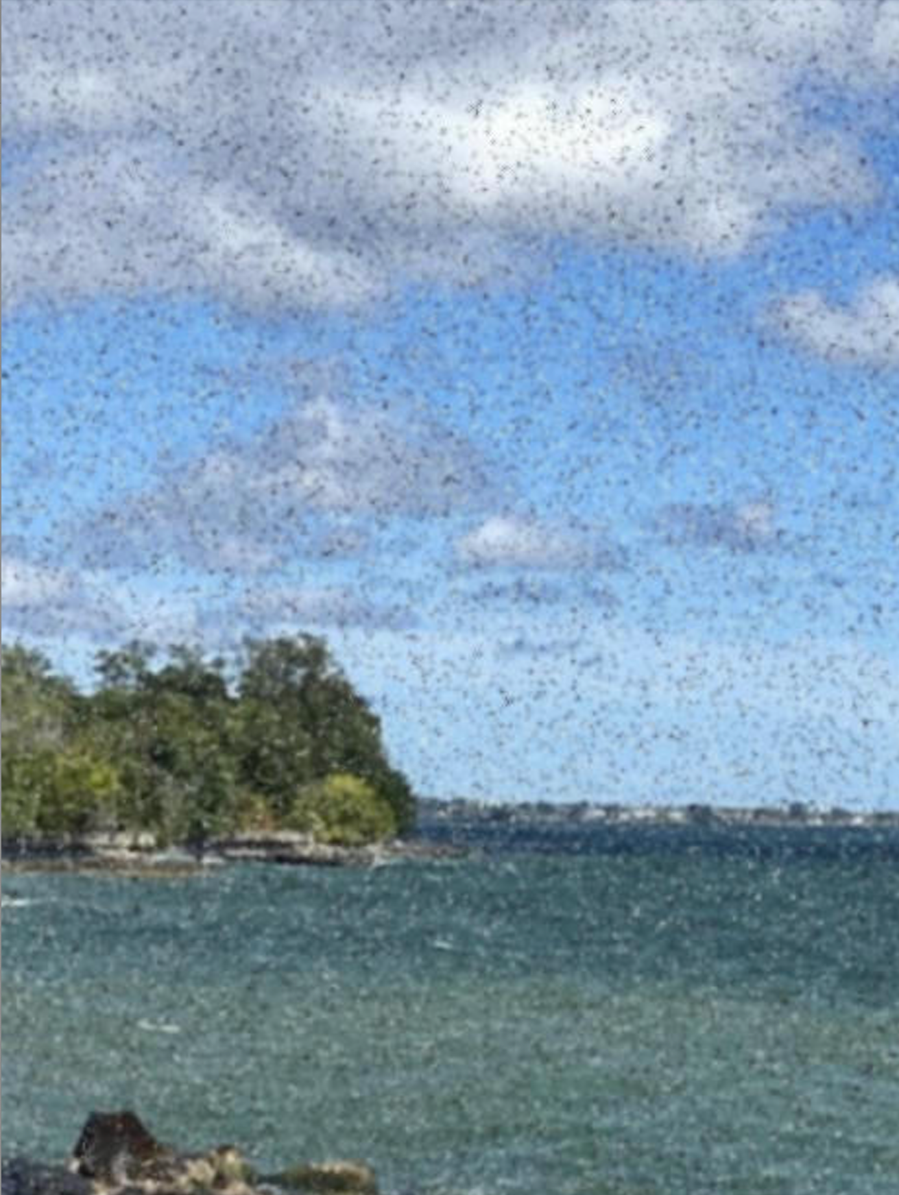
Problem arised!
Original
Salted
filtered

Slide 21
Problem arised
Introduce salts and pepers to the image
Salts have RBG value [1, 1, 1], and pepers are [0, 0, 0].
Salts and pepers are outliers!

Slide 22
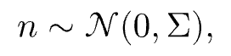
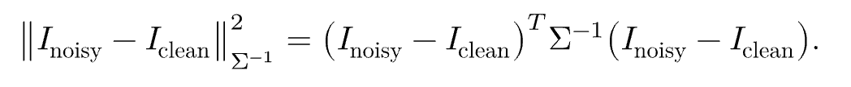
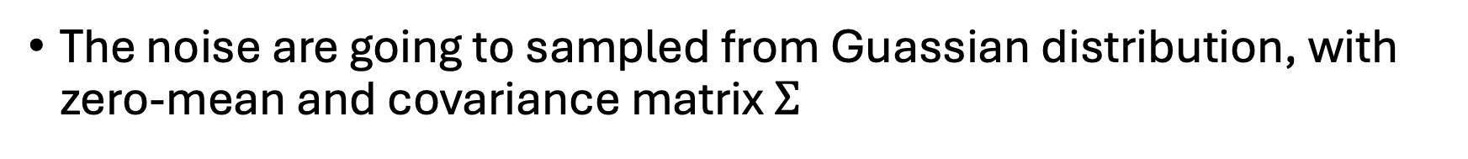
Experiemnt No. 2 and 3
The noise are going to sampled from Guassian distribution, with zero-mean and covariance matrix $Σ$
And the norm induces a Riemannian metric on the color space is a Manalanobis norm

Slide 23
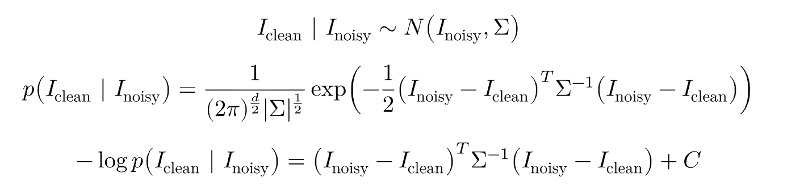
Interpretation and Specialization
[Inter.] Image denoising is in fact Maximum A Posteriori (MAP) estimator for noisy image.

Slide 24
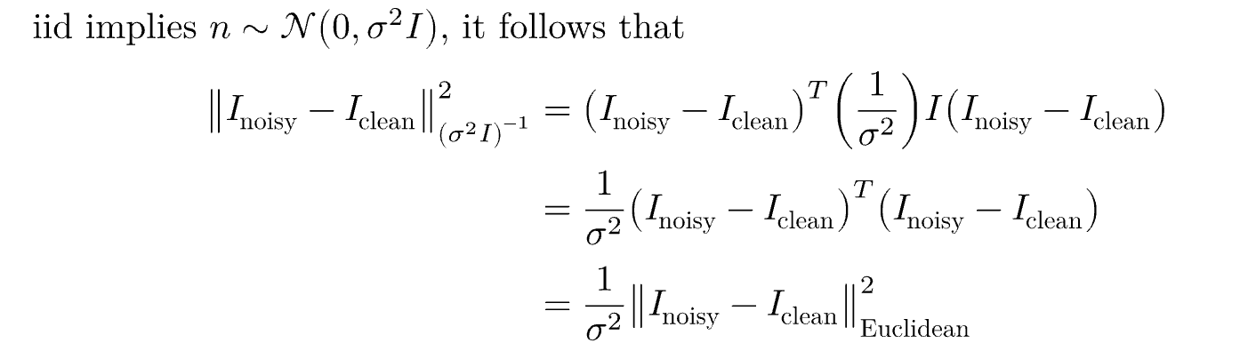
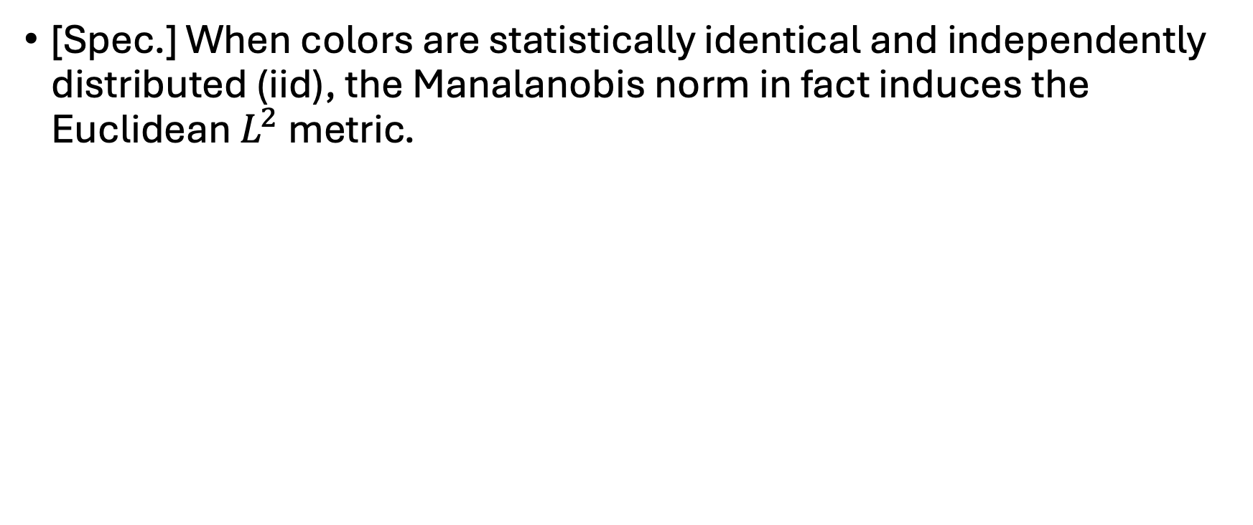
Interpretation and Specialization
[Spec.] When colors are statistically identical and independently distributed (iid), the Manalanobis norm in fact induces the Euclidean $L^{2}$ metric.

Slide 25
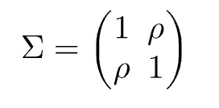
Numerical Stability Concerns
Question: Is all covariance matrix a pratical choice?
Answer: No. The condition of the matrix matters!

Slide 26
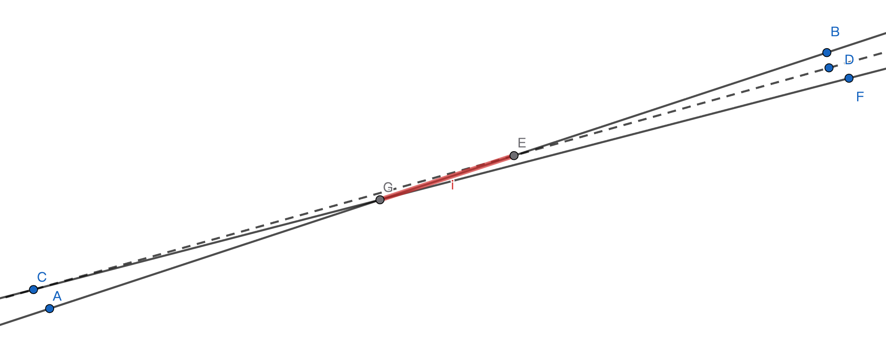
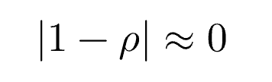
Ill-conditioned matrix

Slide 27
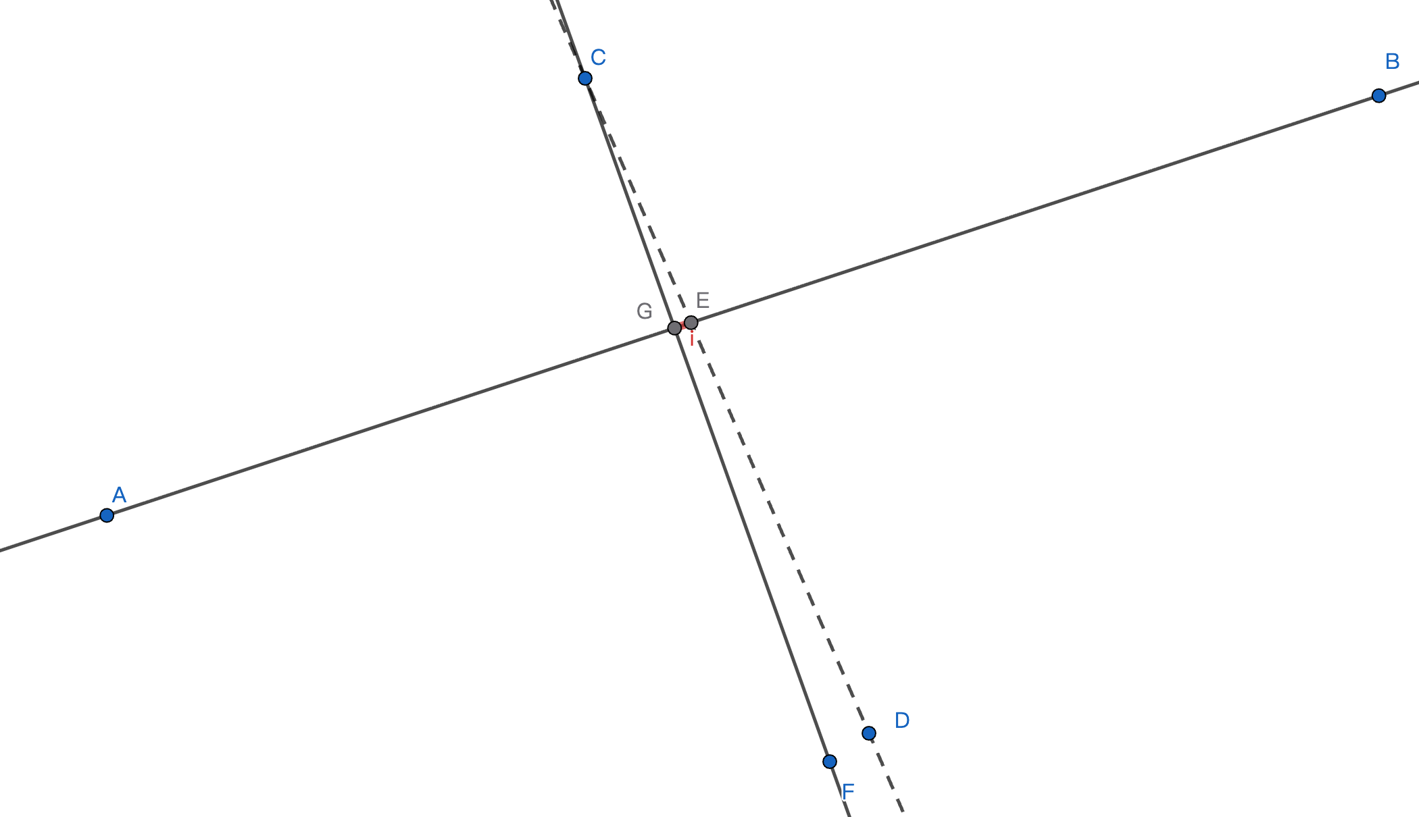
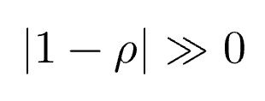
Well-conditioned matrix

Slide 28
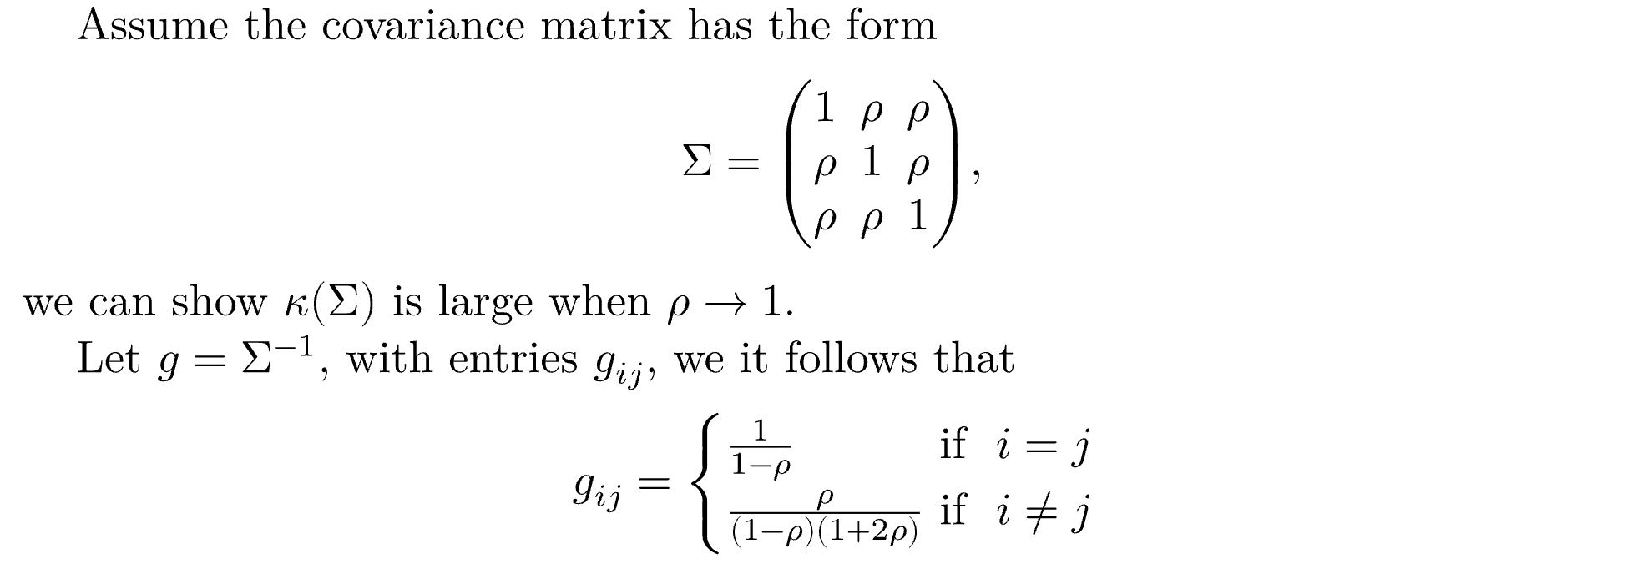
Reflection on the inverse

Slide 29
Question?

Slide 30
Thank you very much!

Slide 31
References
Vos JJ. From lower to higher colour metrics: a historical account. Clin Exp Optom. 2006 Nov;89(6):348-60. doi: 10.1111/j.1444-0938.2006.00091.x. PMID: 17026602.
The Project Gutenberg eBook of Opticks:, by Sir Isaac Newton, Knt.
Britannica Editors. "spectrum." Encyclopedia Britannica, February 21, 2025. https://www.britannica.com/science/spectrum.
Bayram, Özlem Sarikaya, and Özgür Bayram. 2023. "An Anatomy of Fungal Eye: Fungal Photoreceptors and Signalling Mechanisms" Journal of Fungi 9, no. 5: 591. https://doi.org/10.3390/jof9050591
Stiles, WS; Burch, JM (1959). "NPL colour-matching investigation: final report". Optica Acta. 6. doi:10.1080/713826267.
A Beginner’s Guide to (CIE) Colorimetry | by Chandler Abraham | Color and Imaging | Medium
Yoshi Ohno, "CIE Fundamentals for Color Measurements" in Proc. IS&T Int'l Conf. on Digital Printing Technologies (NIP16), 2000, pp 540 - 545, https://doi.org/10.2352/ISSN.2169-4451.2000.16.1.art00033_2
XYZ color system and color spaces
MacAdam ellipse - Wikipedia

